Slide 1
Automated Analysis of Children Emotion Expression levels
Madhuka Nadeeshani, Kovisha Kalaichelvan, Dr. Anuradha Karunasena, Dr. Pradeepa Samarasinghe
Paper ID: ICIT22-000186

Slide 2
Introduction
Extracting and understanding of emotion has a high importance in interaction between human and machine communication. Emotions can be expressed in a multitude of ways, out of which facial expressions are the most prominent and most effective [1].
Importance of age-wise facial emotion expression and emotion level analysis are proven to be essential in clinical context [2].
This research compares deep learning (DL) and machine learning (ML) techniques used for child emotion level prediction and analyzes action unit (AU) stimulation for emotion levels which is consistent with Facial action coding system (FACS) [3].

Slide 3
Research Objectives
Automatically identify the AU stimulation of children on their facial expressions.
Develop 3DCNN and AU based models to analyze the varying emotion levels of children in videos.
Performing age wise emotion level classification based on CNN and AU based models.

Slide 4




Methodology- Objective 1 Identification of AU stimulation in Child Emotion levels.
FACS is an anatomy based that represents facial expressions as muscle movements called AU.
AU06
Cheek Raiser
AU15
Lip Corner Depressor
AU10
Upper Lip Raiser
AU05
Upper lid raiser
Figure 1: Facial Action units

Slide 5
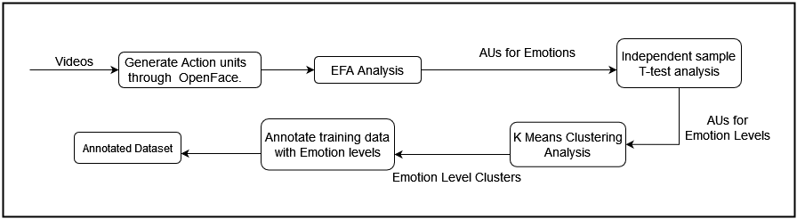
Methodology- Objective 1 Identification of AU stimulation in Child Emotion levels.
Exploratory factor analysis (EFA) followed by K means clustering is done to identify the AU stimulations for emotion levels.
AU stimulations identified are used in creating an emotion level wise annotated data.
Figure 2: EFA Analysis process

Slide 6
Methodology- Objective 2 Emotion level prediction from DL and AU based ML models using videos
1. AU based ML Model
The AUs identified via EFA and t-test are utilized to predict the Emotion levels (High, Moderate, Low) in videos through ML model.
2. Deep Learning based Model
3DCNN model was used to predict different emotions (happy, sad, anger, surprise, fear and disgust) of children along with probability values and then a clustering mechanism was followed to detect emotion levels (High, Moderate, Low ) using probability values.
3DCNN model consists of three convolution3D layers, two max pooling 3D layers, two dropout layers and two dense layers with Haar Cascade classifier as face detector [5].

Slide 7
Methodology- Objective 2 Emotion level prediction from DL and AU based ML models using videos
Datasets
1. The LIRIS Children Spontaneous Facial Expression Video Dataset [4]
LIRIS database contains 215 videos with six spontaneous facial expressions (happy, sad, anger, surprise, disgust, and fear) with a mean age of 7.3 years.
2. DuckEES dataset [5]
DuckEES dataset contains 142 videos with a mean age of 13.24 years, expliciting disgust, embarrassment, fear, sad, happy, pride, and neutral facial expressions.

Slide 8
Methodology – Objective 3 Emotion level prediction from DL and AU based ML models using Images
1. AU based ML Model
Emotion level analysis on images are done utilizing the AU based ML model built under objective 2.
The image analysis was done for the same data tested with the Deep learning-based model
2. Deep Learning based Model
CNN based image analysis was performed using four age categories: below 1 year, 1 to 4 years, 4 to 6 years, and 6 to 10 years).
Data augmentation was performed to increase number of images in 1-4 years and 6- 10 years age categories.

Slide 9
Methodology – Objective 3 Emotion level prediction from DL and AU based ML models using Images
1. Child Affective Facial Expression set (CAFE) [ 6]
Contains 1193 image frames that shows variation of the seven basic facial emotions such as happy, sad, surprise, disgust, anger, fear and neutral
2. City Infant database [7]
Contains 154 images, consisting of 60, 54, and 40 images for positive, negative, and neutral emotions

Slide 10
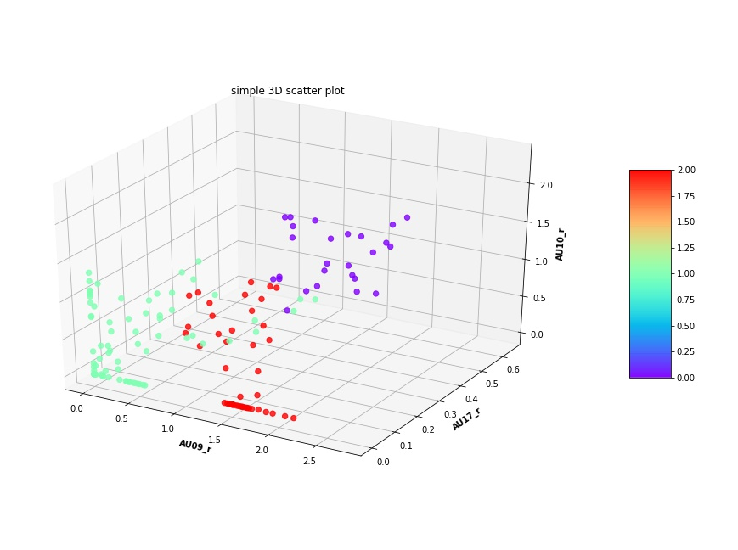
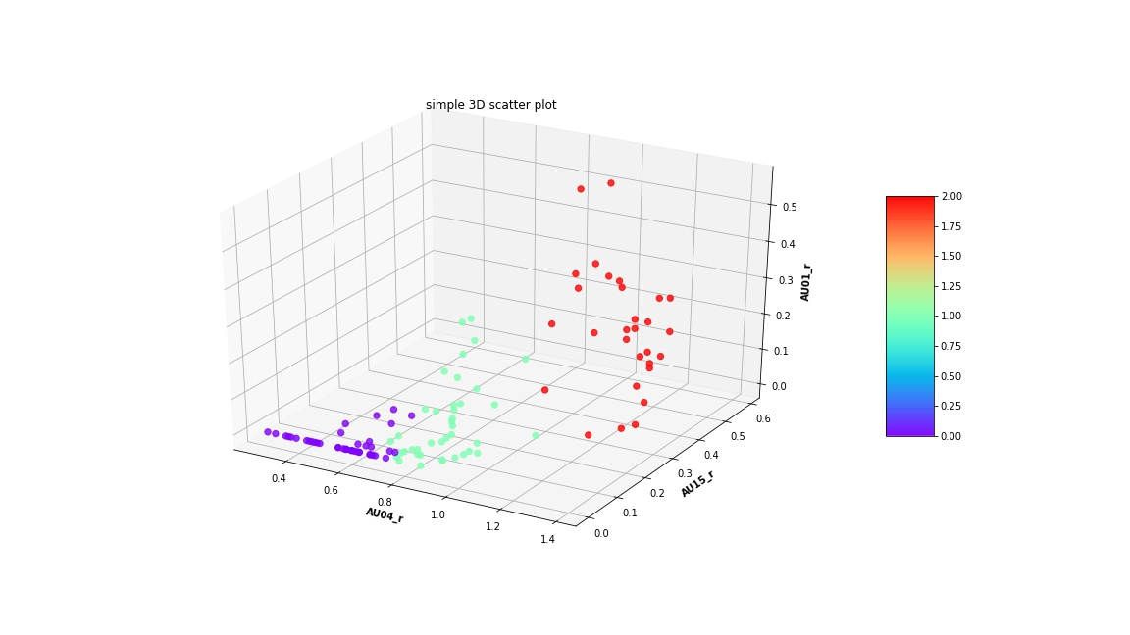
Results and discussion – Objective 1 Relationship between AUs and emotion level
The AU stimulations for emotion levels are derived by EFA and t-tests which is further categorized into clusters with K means clustering algorithm.
Figure 3: Disgust Emotion Levels
Figure 4: Sad Emotion Levels

Slide 11
Results and discussion – Objective 2 Relationship between AUs and emotion level
Comparison between Adult and Child AU stimulation for Emotion levels from EFA and T-test analysis.
Emotion | Adult |  | Child
 | EFA | T-test | EFA | T-test
Happy | 6, 10, 12, 14, 25 | 6, 10, 12 | 6, 7, 10, 12, 25 | 6, 7, 10, 12, 25
Sad | 4, 15, 17 | 15, 17 | 1, 4 ,15 | 1, 4 ,15
Disgust | 4, 9, 17, 23 | 4, 9 | 9, 10, 17 | 9, 10, 17

Slide 12
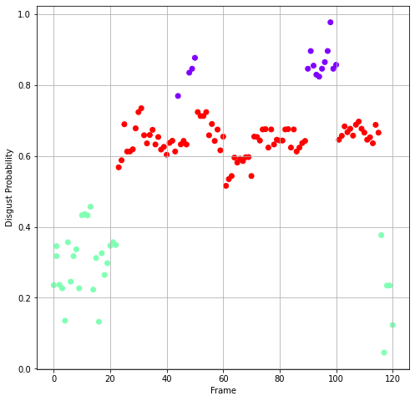
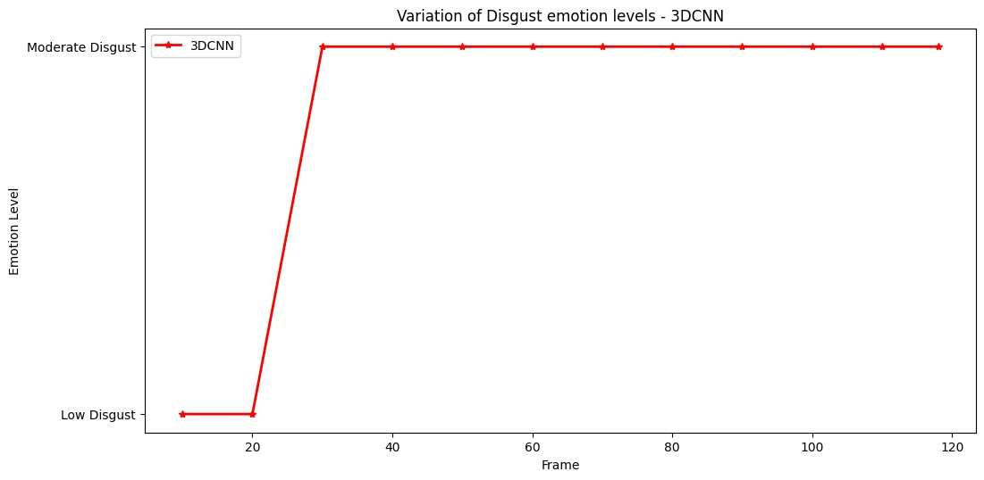
Results and discussion – Objective 2 Emotion level prediction from DL and AU based ML models using videos
1. AU based ML model
Based on the predictions obtained from the AU based ML classifier the emotion levels seen throughout the video are identified.
2. Deep learning based model
Based on the probability values of emotions, clusters were identified as shown in figure and then levels were defined for video based on cluster values.
Figure 5: Cluster for disgust video
Figure 6: Disgust emotion levels

Slide 13
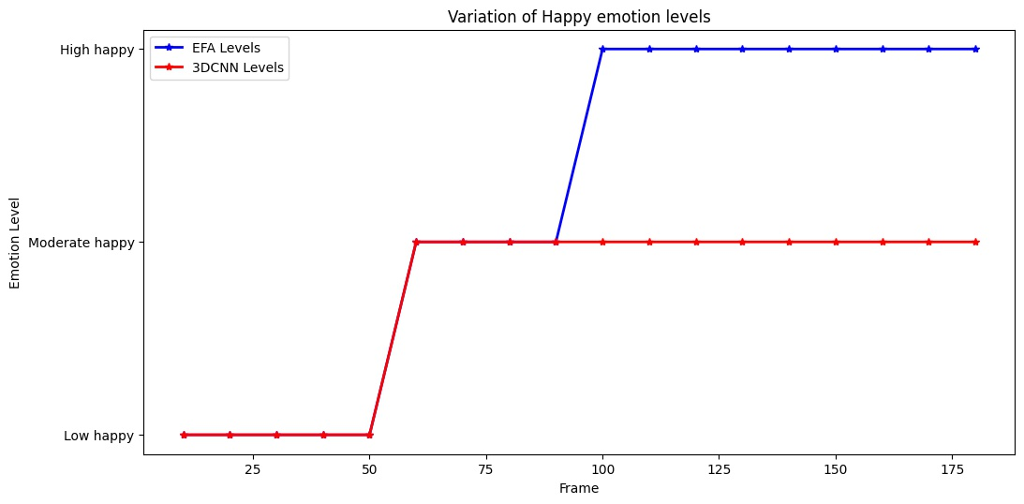
Results and discussion – Objective 2 Emotion level prediction from DL and AU based ML models using videos
For testing ML and 3DCNN model LIRIS and Emo react databases were used, where 91.04% and 82.64%% accuracy levels were obtained for ML and DL based Emotion level predictions, respectively
Figure 7: Emotion Level variation in EFA and 3DCNN models

Slide 14
Results and discussion – Objective 3 Emotion level prediction from DL and AU based ML models using Images
1. AU based ML Model
For the age wise images utilized in the DL model, the emotion level predictions obtained via an AU based model were further analyzed.
2. Deep learning based model
For the 3DCNN model 79.89%, 60.89% , 86.65% and 70.65% accuracies were obtained for below 1 year, 1 to 4 years, 4 to 6 years, and 6 to 10 years, age categories respectively.

Slide 15
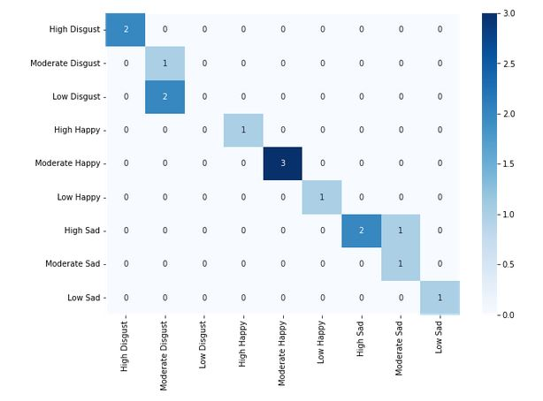
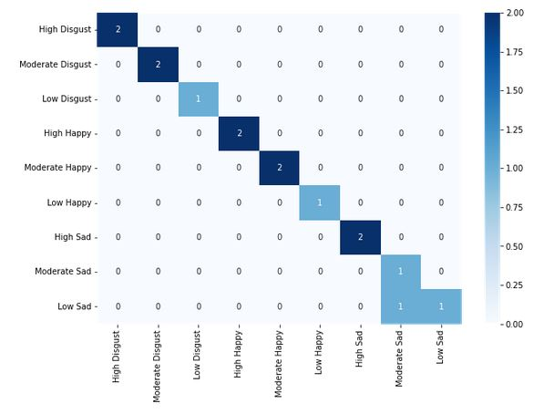
Results and discussion – Objective 3 Emotion level prediction from DL and AU based ML models using videos
EFA based Analysis
3DCNN based Analysis
Figure 8: Confusion matrix for 1- 4 years age category

Slide 16
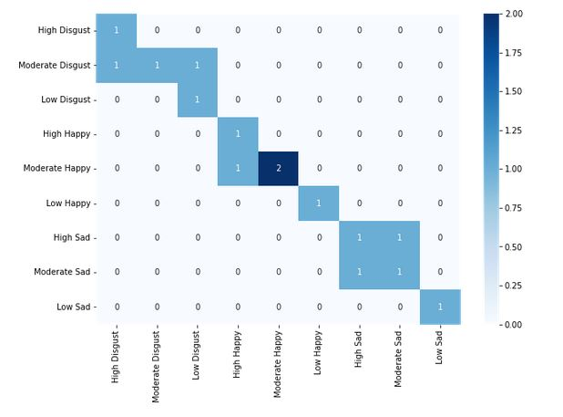
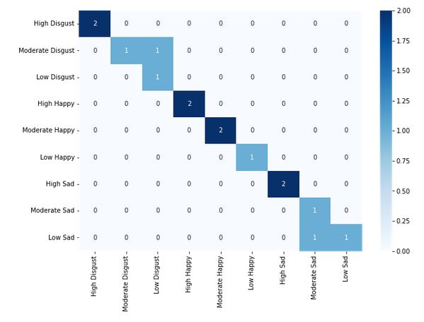
Results and discussion – Objective 3 Emotion level prediction from DL and AU based ML models using videos
EFA based Analysis
3DCNN based Analysis
Figure 9: Confusion matrix for 6- 10 years age category

Slide 17
Conclusion
The AU based emotion and level predictions show promising results and the EFA approach of AU mapping for emotions is consistent with the FACS.
EFA approach outperformed emotion level prediction in all cases when compared with CNN approaches.
Happy emotion prediction in age wise emotion analysis resulted in a higher accuracy over sad and disgust emotions.
Clinicians and other health related professionals can identify the contribution of each AU for the predicted emotion levels and identify any abnormalities and the causes through our model.

Slide 18
Future work
Analyse the AU stimulation variation for emotion levels comparing different age categories of children.
Performing a DL based video emotion recognition considering different age categories.
As emotion level prediction in age wise analysis display mixed results, a further research on age wise AU stimulation is needed.

Slide 19
References
[1] Phillips, M. L., Drevets, W. C., Rauch, S. L., & Lane, R. (2003). Neurobiology of emotion perception I: The neural basis of normal emotion perception. Biological psychiatry, 54(5), 504-514.
[2] Ekman, “Facial action coding system,” Environmental Psychology & Nonverbal Behavior, 1978.
[3] S. Sullivan, T. Ruffman, and S. B. Hutton, “Age differences in emotion recognition skills and the visual scanning of emotion faces,” The Journals of Gerontology Series B: Psychological Sciences and Social Sciences, vol. 62, no. 1, pp. P53–P60, 2007.
[4] R. A. Khan, A. Crenn, A. Meyer, and S. Bouakaz, “A novel database of children’s spontaneous facial expressions (liris-cse),” Image and Vision Computing, vol. 83, pp. 61–69, 2019.
[5] N. R. Giuliani, J. C. Flournoy, E. J. Ivie, A. Von Hippel, and J. H. Pfeifer, “Presentation and validation of the duckees child and adolescent dynamic facial expressions stimulus set,” International journal of methods in psychiatric research, vol. 26, no. 1, p. e1553, 2017.
[6]P. Viola and M. Jones, “Rapid object detection using a boosted cascade of simple features,” in Proceedings of the 2001 IEEE computer society conference on computer vision and pattern recognition. CVPR 2001, vol. 1. Ieee, 2001, pp. I–I.
[7]V . LoBue and C. Thrasher, “The child affective facial expression (cafe) set: Validity and reliability from untrained adults,” Frontiers in psychology, vol. 5, p. 1532, 2015
[8] R. Webb, S. Ayers, and A. Endress, “The city infant faces database: A validated set of infant facial expressions,” Behavior research methods, vol. 50, no. 1, pp. 151–159, 2018.

Slide 20
Thank you!!

